Slide 1
HOUSE PRICE PREDICTION
An End To End Machine Learning Case Study
By Akash Singh

Slide 2
Objectives
01
To apply data preprocessing and preparation techniques in order to obtain clean data
02
To build machine learning models able to predict house price based on house features
03
To analyze and compare models performance in order to choose the best model

Slide 3
Walk Through
The Dataset Contains 2930 Records & 82 Features .
Worked On The Statistical Information Of The Data .
Dealt with the missing values of the dataset .
Outlier Removal & Deleting Un-useful Columns .
Target Variable Distribution .
Correlation Between The Variables .
Relationship Between The Target Variables & Other Variables.
Relationship Between Predictor Variables.
Creating New Derived Features & Dealing With Ordinal Features.
One Hot Encoding For Categorical Features.
Performed Feature Scaling
Analysis & Interpretation Of Models

Slide 4
Missing Value Imputation
Pool Qc
Lot Frontage
Lot Frontage represents the linear feet of street connected to the house. So we assume that the missing values in this column indicates that the house is not connected to any street, and filling in the missing values with 0.
The percentage of missing values in Pool QC column is 99.56% which is very high. I think that a missing value in this column denotes that the corresponding house doesn't have a pool.
there are 2917 entries in Pool Area column that have a value of 0. This verified our hypothesis that each house without a pool has a missing value in Pool QC column and a value of 0 in Pool Area column .Filling the missing values in Pool QC column with "No Pool":
Garage Cond, Garage Qual, Garage Finish, Garage Yr Blt, Garage Type, Garage Cars, and Garage Area
NA in Garage Cond, Garage Qual, Garage Finish, and Garage Type indicates that there is no garage in the house. So we fill in the missing values in these columns with "No Garage". notice that Garage Cond, Garage Qual, Garage Finish, Garage Yr Blt columns have 159 missing values, but Garage Type has 157 and both Garage Cars and Garage Area have one missing value. Let's take a look at the row that contains the missing value in Garage Cars.
Replace the values of Garage Type with "No Garage" in these two rows also.
For Garage Yr Blt, filling in missing values with 0 since this is a numerical column.
Alley, Fence, and Fireplace Qu
According to the dataset documentation, NA in Alley, Fence, and Fireplace Qu columns denotes that the house doesn't have an alley, fence, or fireplace. So filling in the missing values in these columns with "No Alley", "No Fence", and "No Fireplace" accordingly.

Slide 5
Missing Value Imputation
Bsmt Exposure, BsmtFin Type 2, BsmtFin Type 1, Bsmt Qual, Bsmt Cond, Bsmt Half Bath, Bsmt Full Bath, Total Bsmt SF, Bsmt Unf SF, BsmtFin SF 2, and BsmtFin SF 1 .
Mas Vnr Area and Mas Vnr Type
Each of these two columns have 23 missing values. filling in these missing values with "None" for Mas Vnr Type and with 0 for Mas Vnr Area. useing "None" for Mas Vnr Type because in the dataset documentation, "None" for Mas Vnr Type means "None" (i.e. no masonry veneer):
According to the dataset documentation, NA in any of the first five of these columns indicates that there is no basement in the house. So filling in the missing values in these columns with "No Basement". We notice that the first five of these columns have 80 missing values, but BsmtFin Type 2 has 81, Bsmt Exposure has 83, Bsmt Half Bath and Bsmt Full Bath each has 2, and each of the others has 1. look at the rows where Bsmt Half Bath is null.
filling in the missing value in BsmtFin Type 2 for this row with "Unf". According to the dataset documentation, "Unf" for BsmtFin Type 2 means "Unfinished":
Electic This column has one missing value. filling in this value with the mode of this column:

Slide 6
Outlier Removal & Deleting Columns That Are Not Useful
The five values meant by the authour in the plot above.removing them from our dataset.keeping data points that have Gr Liv Area less than 4,000. But first Itake a look at the dataset rows that correspond to these unusual values:
Removing Outliers
Deleting Columns That Are Not Useful
Deleting columns that are not useful in our analysis. The columns to be deleted are Order and PID.

Slide 7
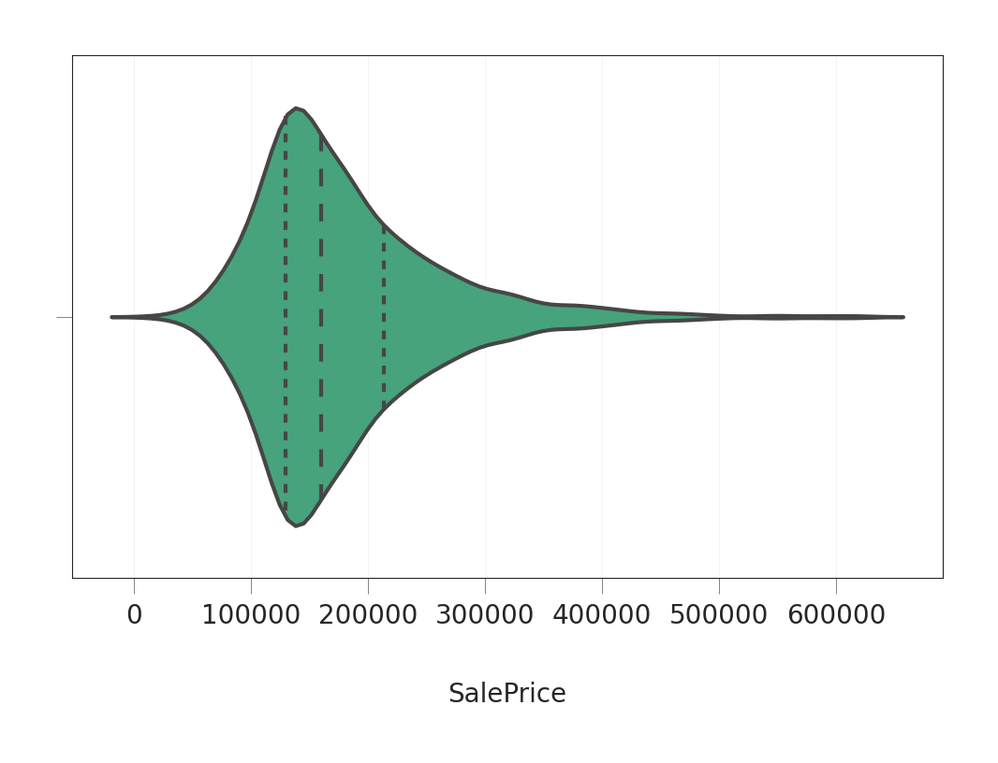
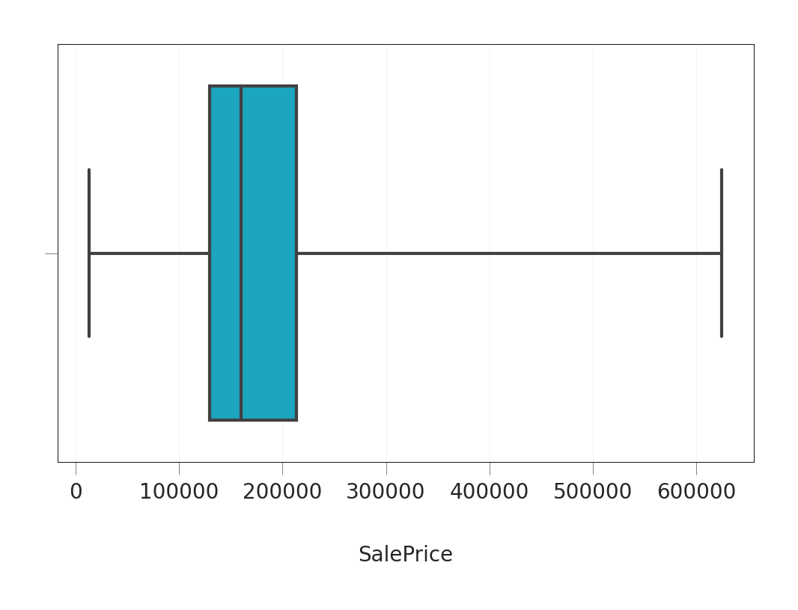
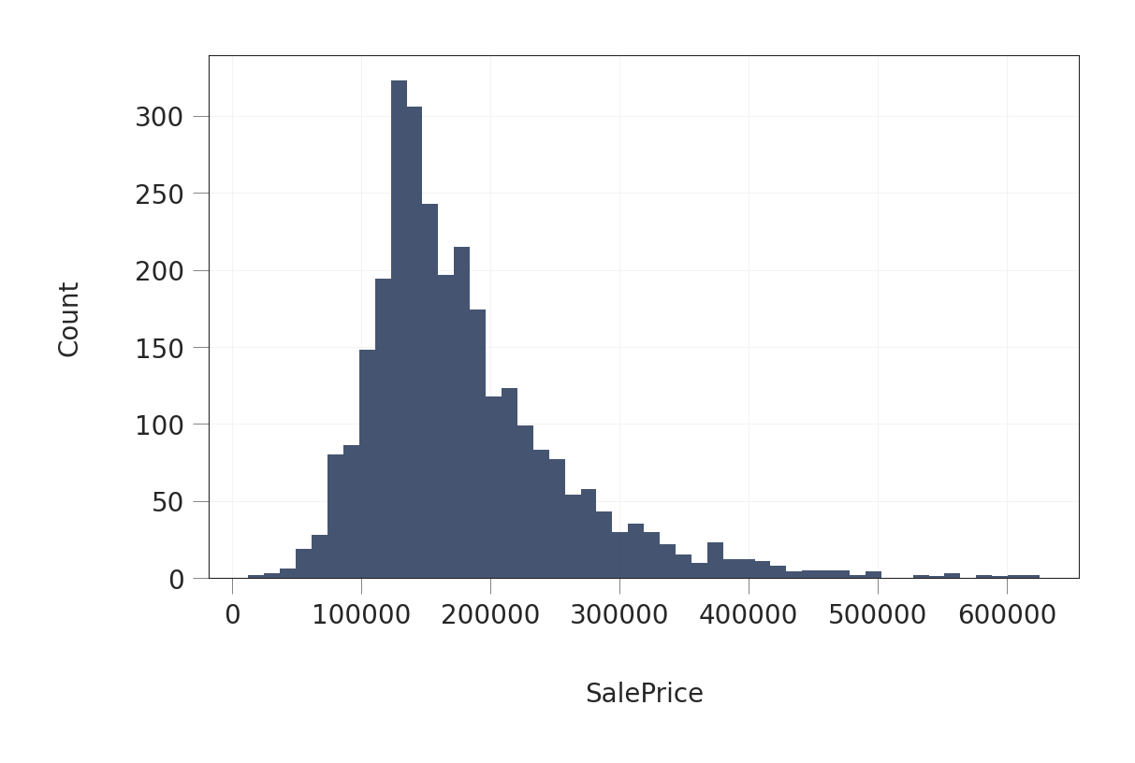
Target Variable Distribution
The plot that most house prices fall between 100,000 and 250,000. The dashed lines represent the locations of the three quartiles Q1, Q2 (the median), and see the box plot of SalePrice.
This shows us the minimum and maximum values of SalePrice. It shows us also the three quartiles represented by the box and the vertical line inside of it. Lastly, plot the histogram of the variable to see a more detailed view of the distribution.

Slide 8
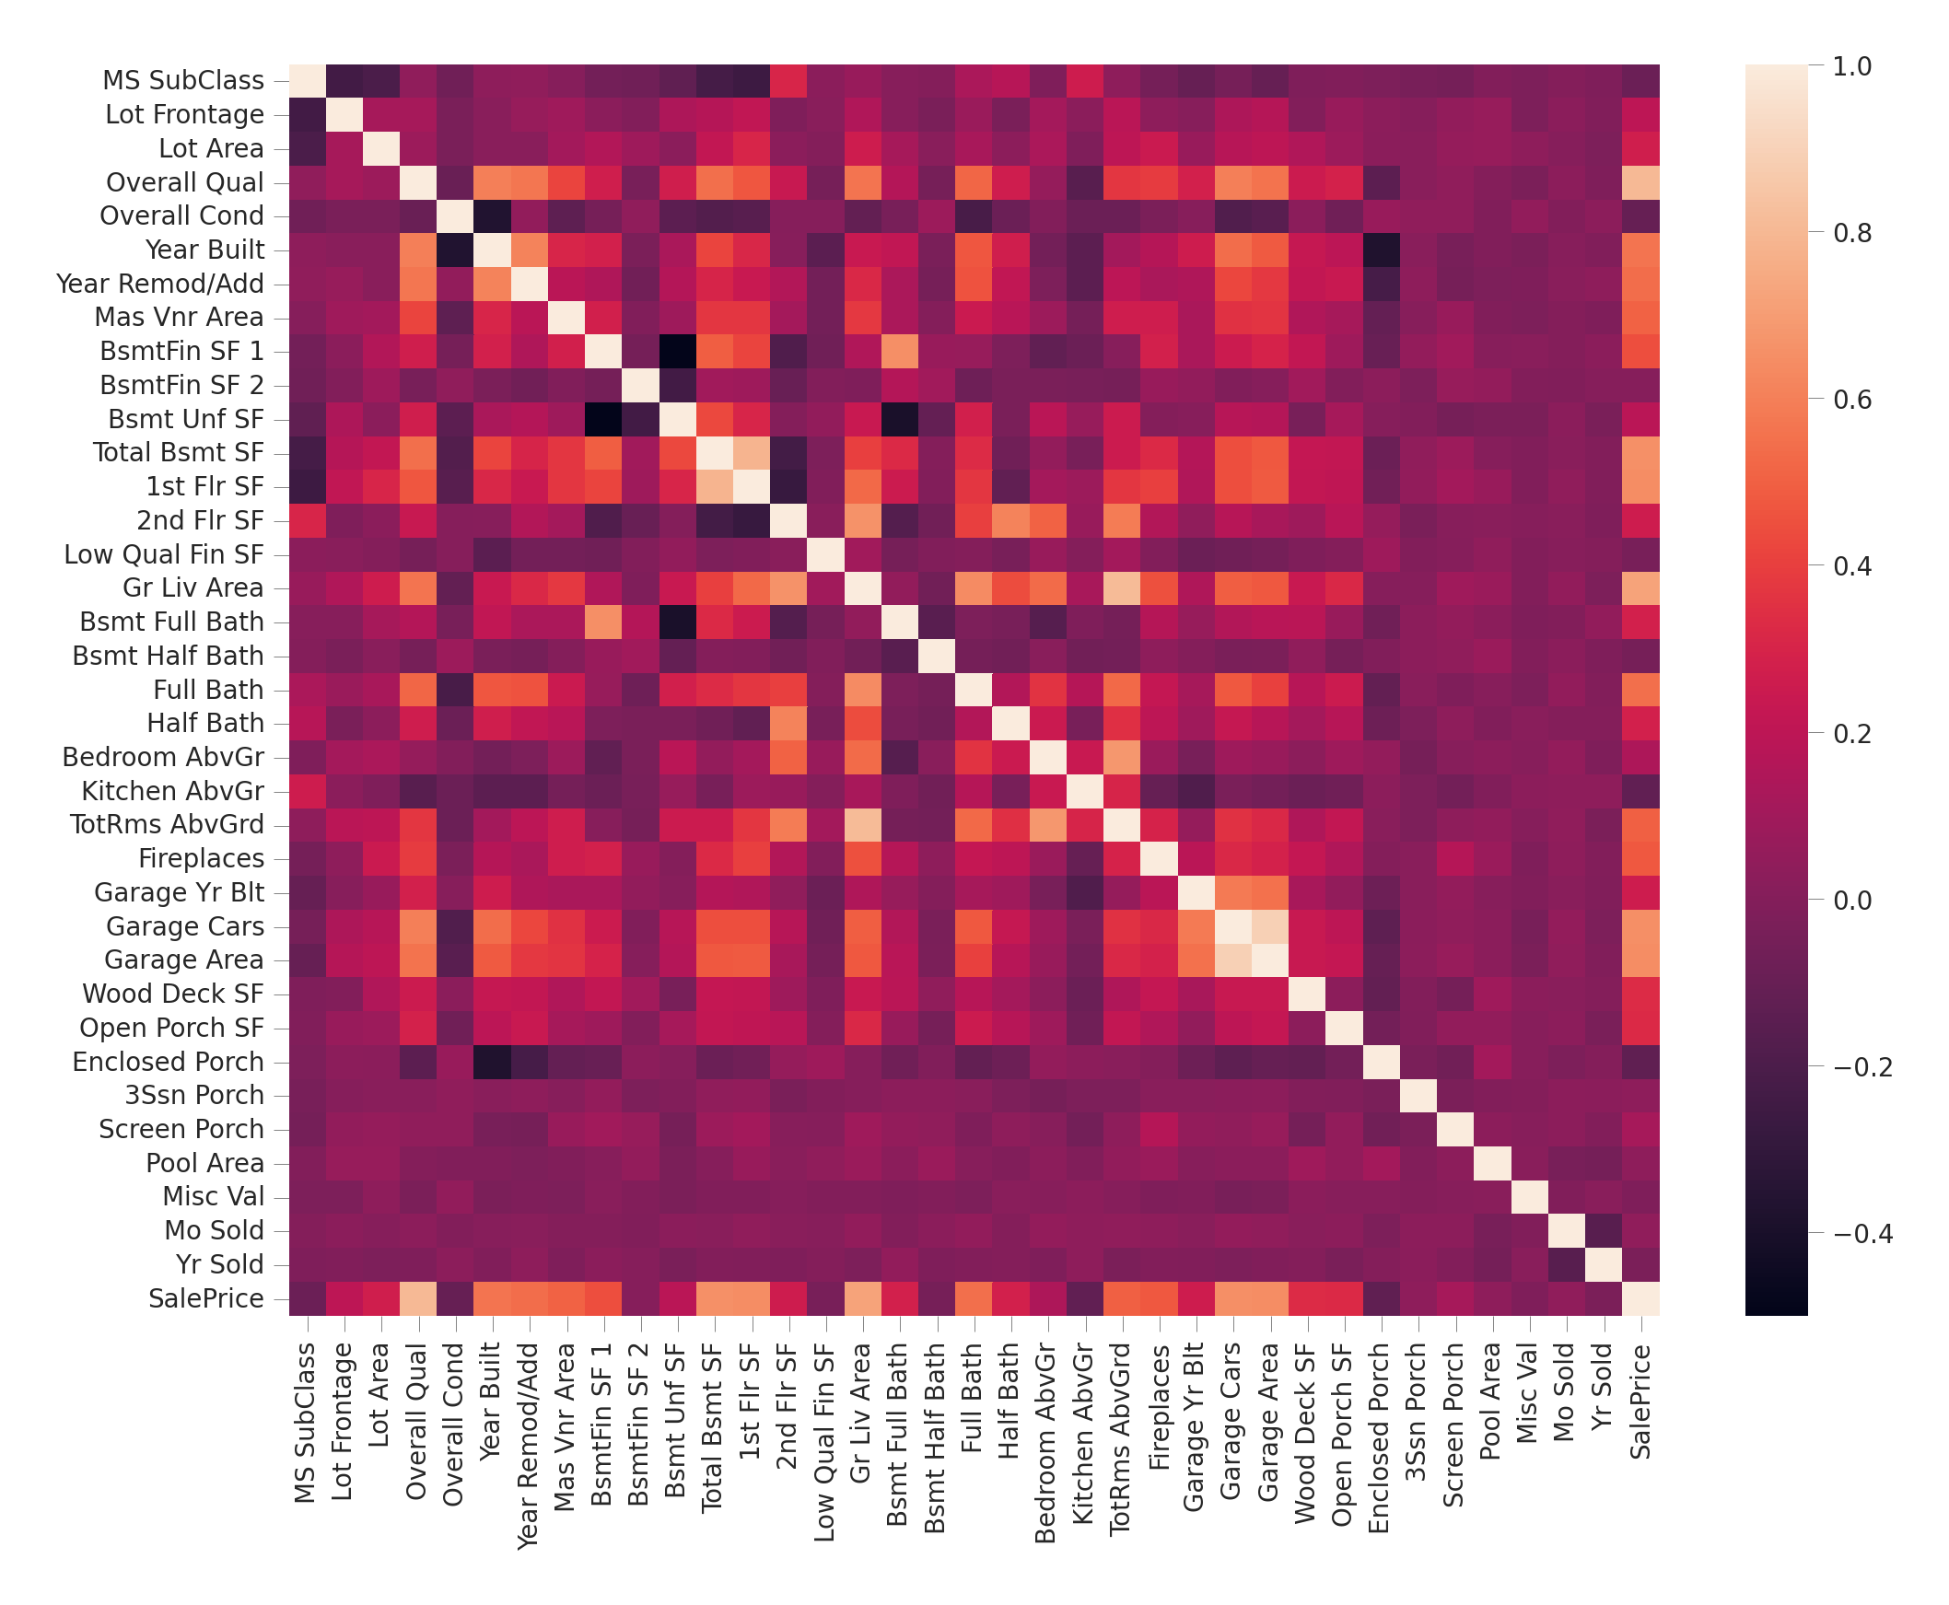
Correlation Between The Variables
That Garage Cars and Garage Area have high positive correlation which is reasonable because when the garage area increases, its car capacity increases too. We see also that Gr Liv Area and TotRms AbvGrd are highly positively correlated which also makes sense because when living area above ground increases, it is expected for the rooms above ground to increase too.
Regarding negative correlation, we can see that Bsmt Unf SF is negatively correlated with BsmtFin SF 1, and that makes sense because when we have more unfinished area, this means that we have less finished area. We note also that Bsmt Unf SF is negatively correlated with Bsmt Full Bath which is reasonable too.
Most importantly,I want to look at the predictor variables that are correlated with the target variable (SalePrice). By looking at the last row of the heatmap, we see that the target variable is highly positively correlated with Overall Qual and Gr Liv Area. We see also that the target variable is positively correlated with Year Built, Year Remod/Add, Mas Vnr Area, Total Bsmt SF, 1st Flr SF, Full Bath, Garage Cars, and Garage Area.

Slide 9

Relationship Between Target Variable & Other Variables
High Positive Correlation
Firstly,visualize the relationships between the target variable and the variables that are highly and positively correlated with it, according to what we saw in the heatmap. Namely, these variables are Overall Qual and Gr Liv Area. We start with the relatioship between the target variable and Overall Qual, but before that, let's see the distribution of each of them. Let's start with the target variable SalePrice
Most house prices fall between 100,000 and 200,000. We see also that there is a number of expensive houses to the right of the plot. Now, see the distribution of Overall Qual variable .

Slide 10
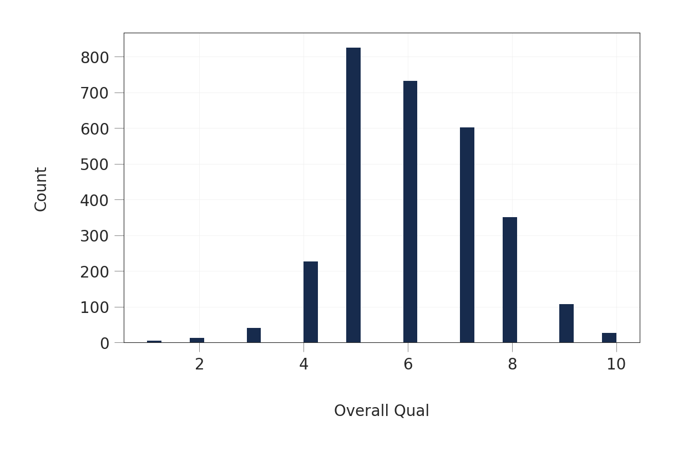
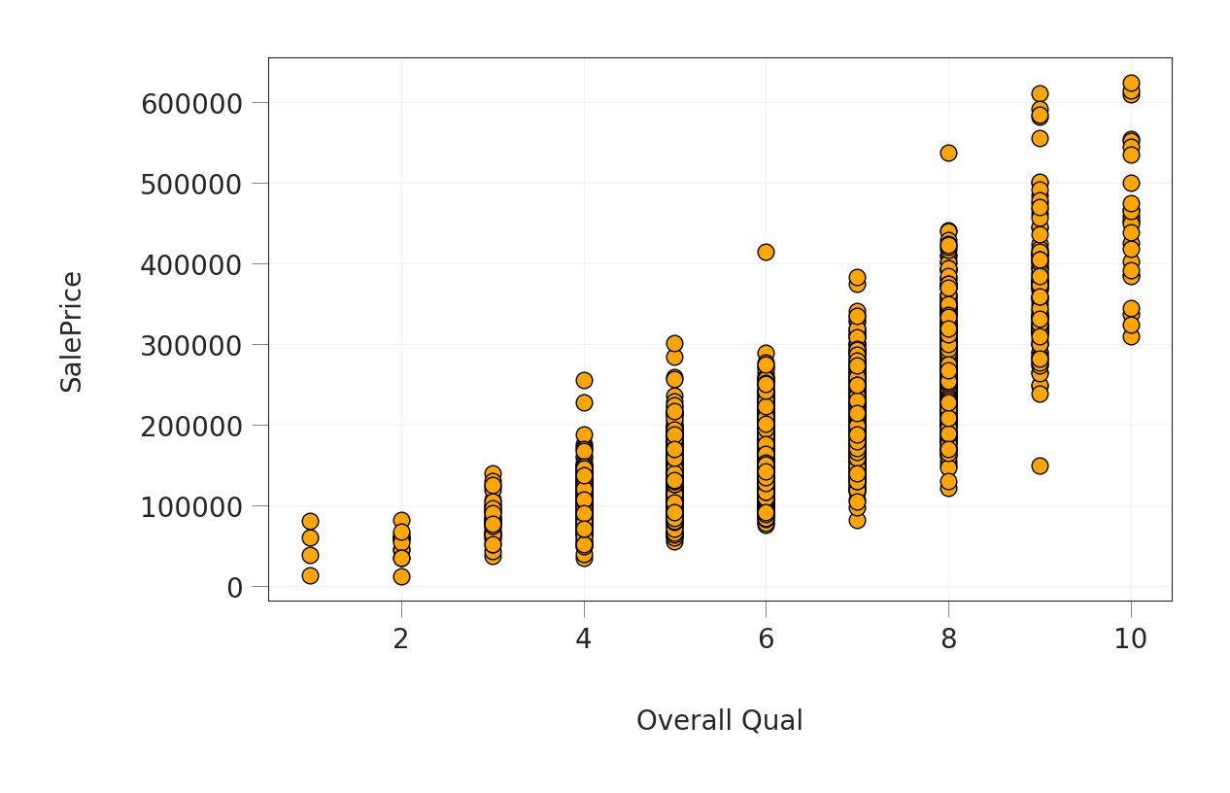
Relationship Between Target Variable & Other Variables
Overall Qual takes an integer value between 1 and 10, and that most houses have an overall quality between 5 and 7. Now we plot the scatter plot of SalePrice and Overall Qual to see the relationship between them
see that they are truly positively correlated; generally, as the overall quality increases, the sale price increases too. This verfies what I got from the heatmap above.
Now,see the relationship between the target variable and Gr Liv Area variable which represents the living area above ground. distribution of Gr Liv Area

Slide 11
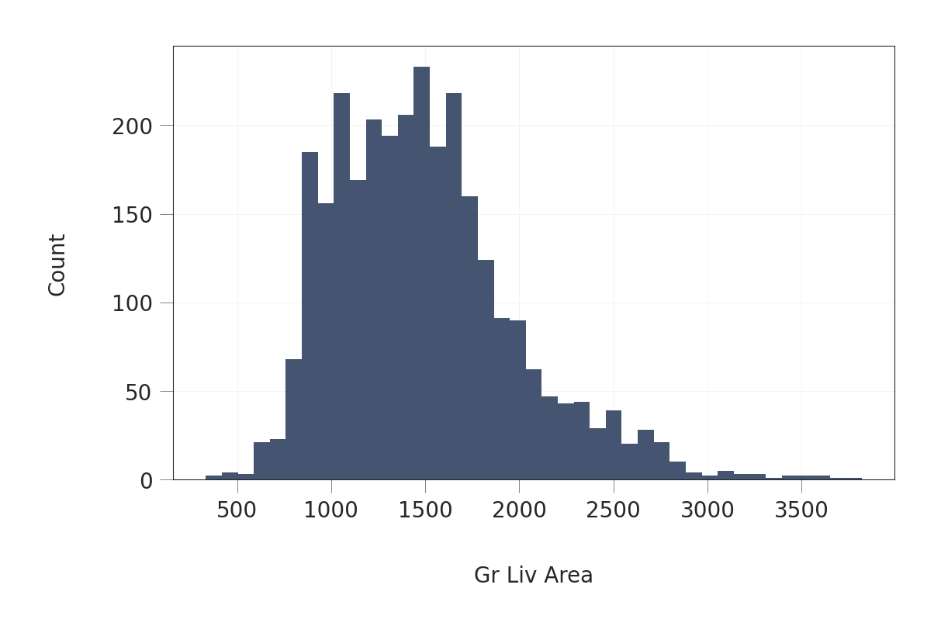
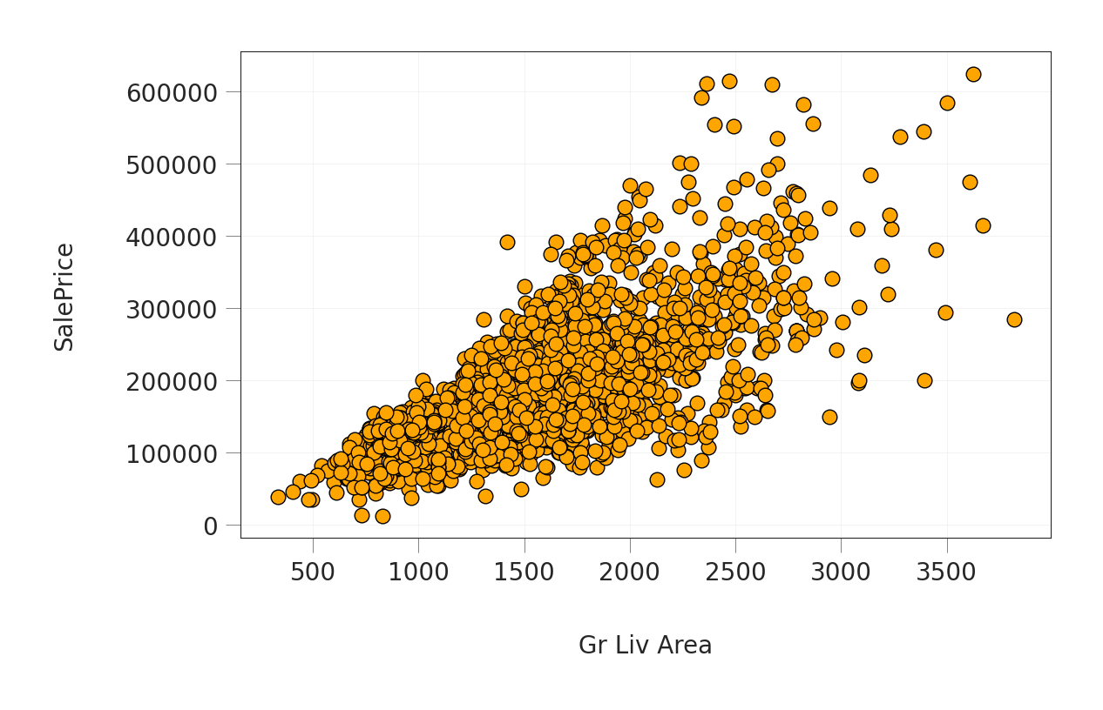
Relationship Between Target Variable & Other Variables
above-ground living area falls approximately between 800 and 1800 SQ.FT . Now, the relationship between Gr Liv Area and the target variable
The scatter plot above shows clearly the strong positive correlation between Gr Liv Area and SalePrice

Slide 12
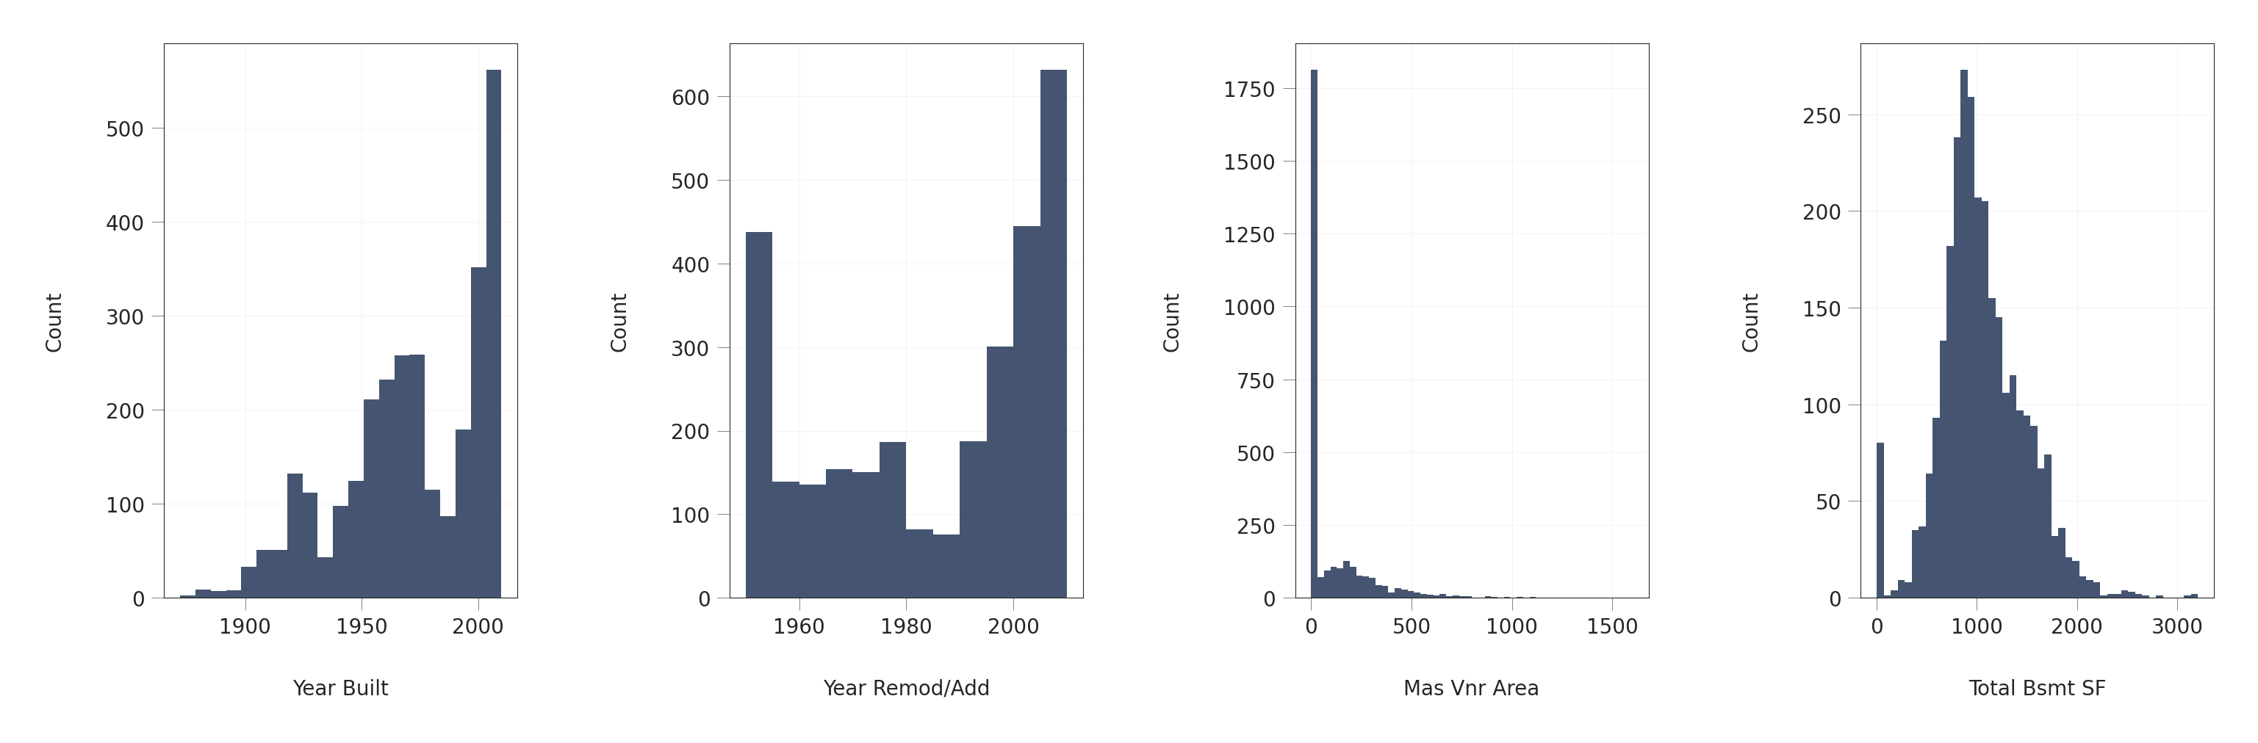
Relationship Between Target Variable & Other Variables
Moderate Positive Correlation
visualize the relationship between the target variable and the variables that are positively correlated with it, but the correlation is not very strong. Namely, these variables are Year Built, Year Remod/Add, Mas Vnr Area, Total Bsmt SF, 1st Flr SF, Full Bath, Garage Cars, and Garage Area. We start with the first four. the distribution of each of them

Slide 13
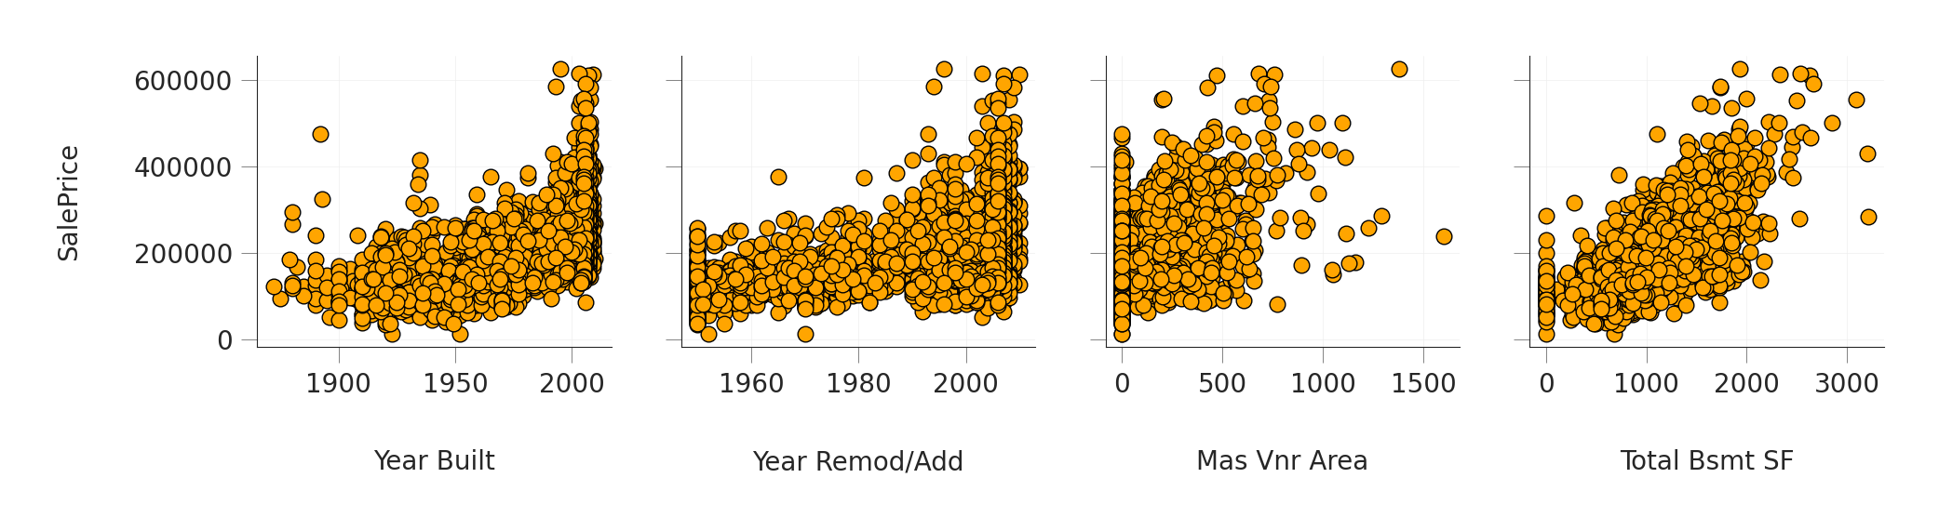
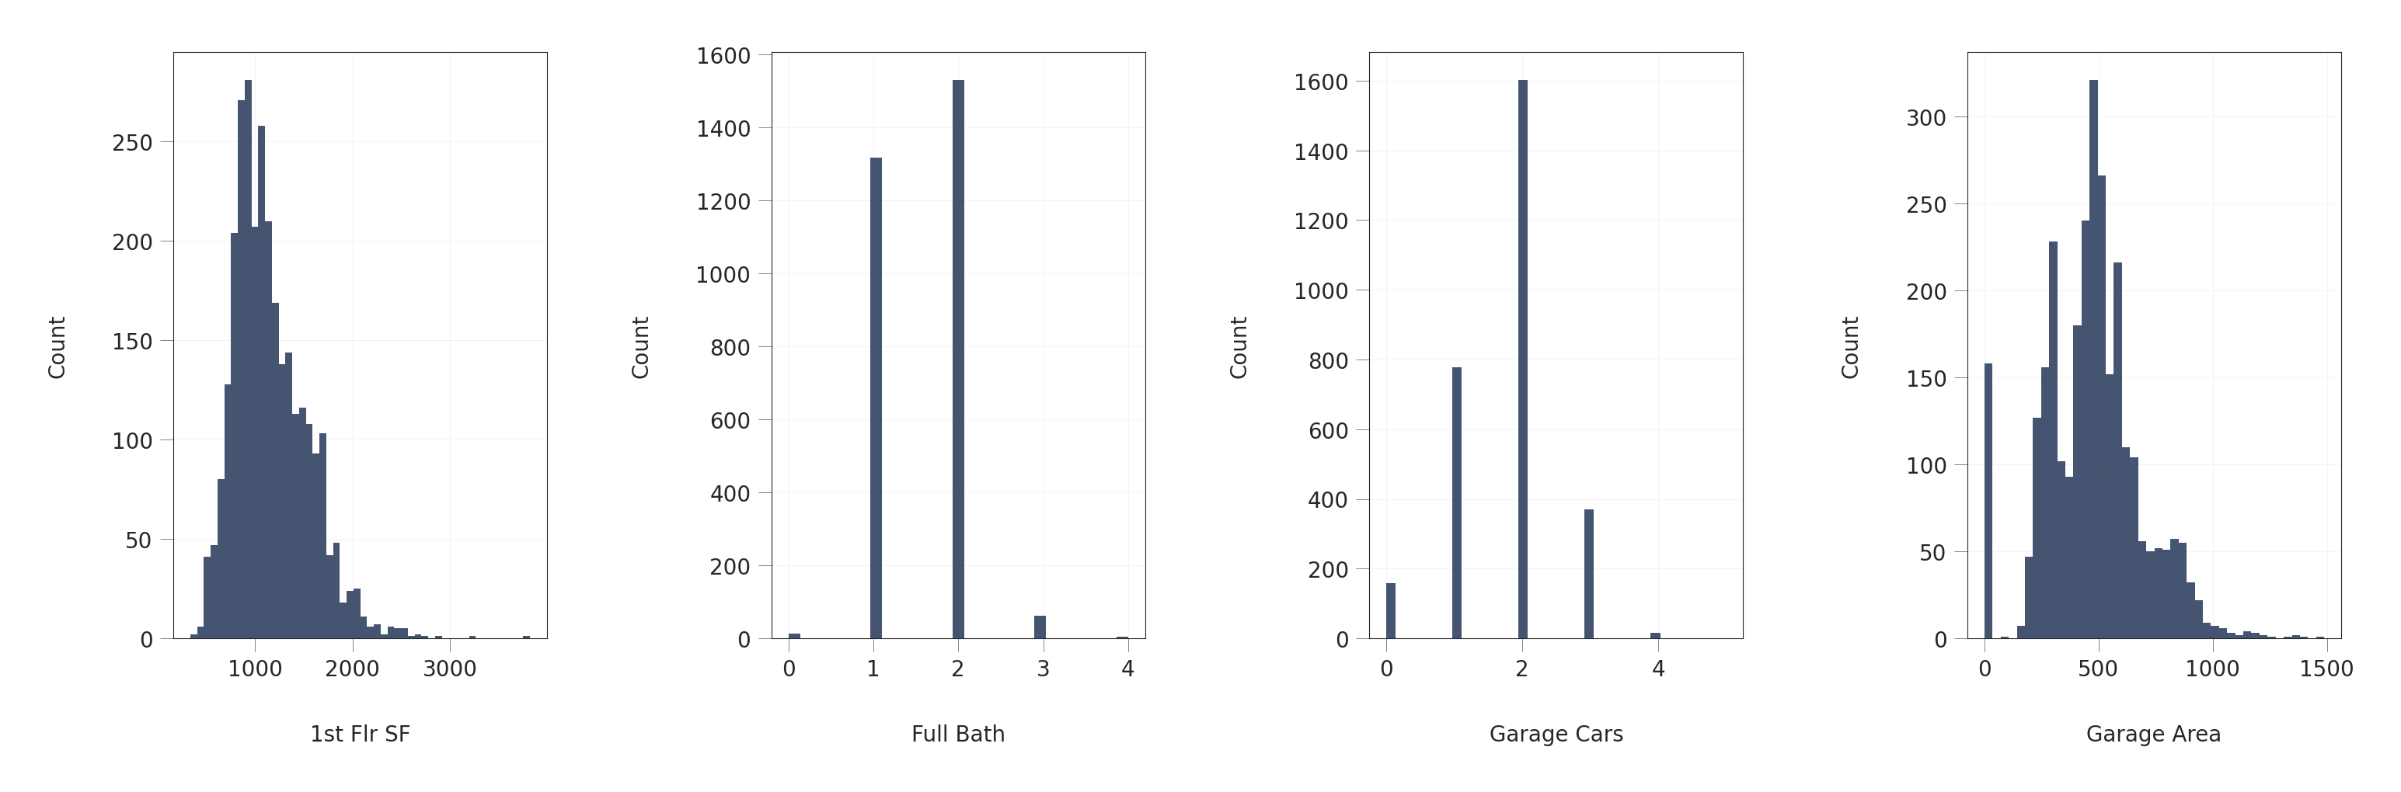
Relationship Between Target Variable & Other Variables
their relationships with the target variable using scatter plots
the last four. the distribution of each of them

Slide 14
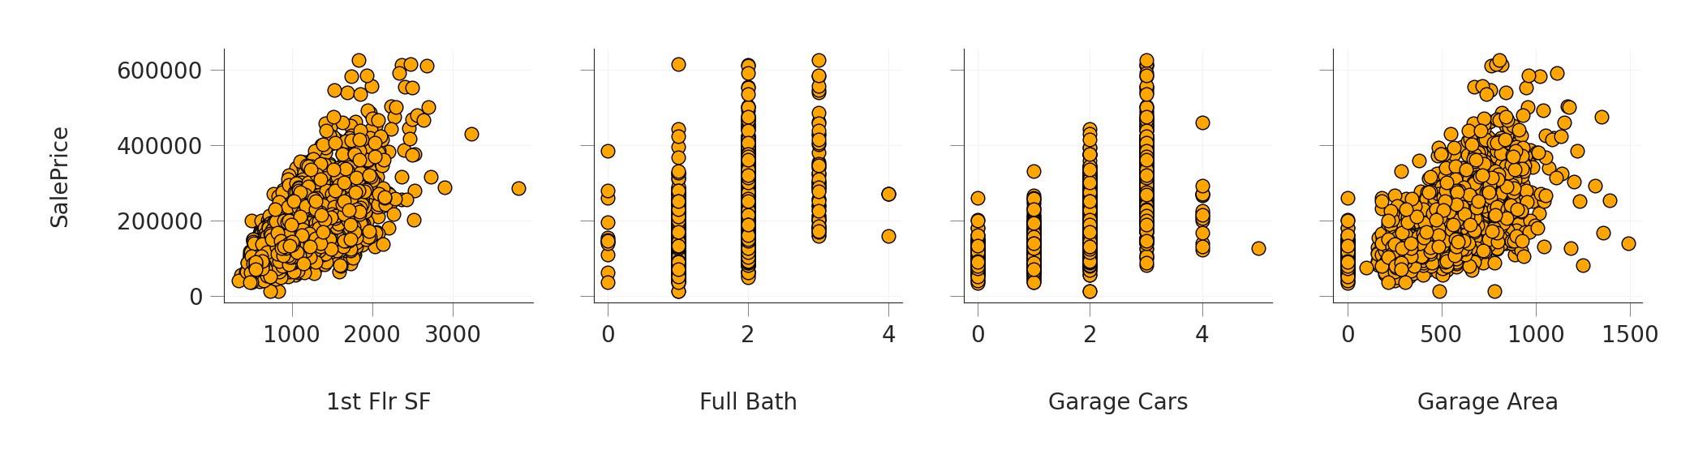
Relationship Between Target Variable & Other Variables
their relationships with the target variable:
From the plots above, these eight variables are truly positively correlated with the target variable. However, it's apparent that they are not as highly correlated as Overall Qual and Gr Liv Area.

Slide 15
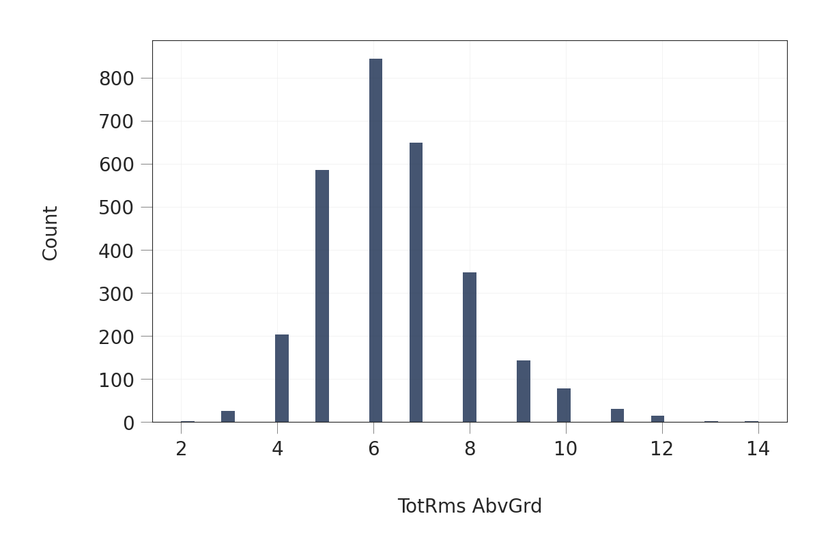
Relationship Between Predictor Variables
Positive Correlation
Apart from the target variable, when I plotted the heatmap, I discovered a high positive correlation between Garage Cars and Garage Area and between Gr Liv Area and TotRms AbvGrd.I want to visualize these correlations also. I've already seen the distribution of each of them except for TotRms AbvGrd.the distribution of TotRms AbvGrd first:

Slide 16
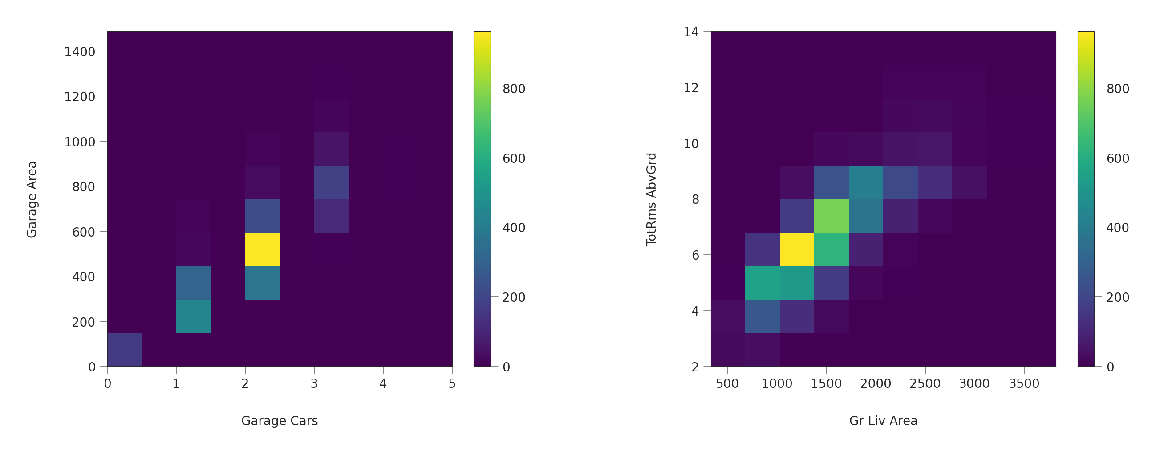
Relationship Between Predictor Variables
visualize the relationship between Garage Cars and Garage Area and between Gr Liv Area and TotRms AbvGrd
the strong correlation between each pair. For Garage Cars and Garage Area, the highest concentration of data is when Garage Cars is 2 and Garage Area is approximately between 450 and 600 SQ.FT. For Gr Liv Area and TotRms AbvGrd, the highest concentration is when Garage Liv Area is roughly between 800 and 2000sq.ft and TotRms AbvGrd is 6.

Slide 17
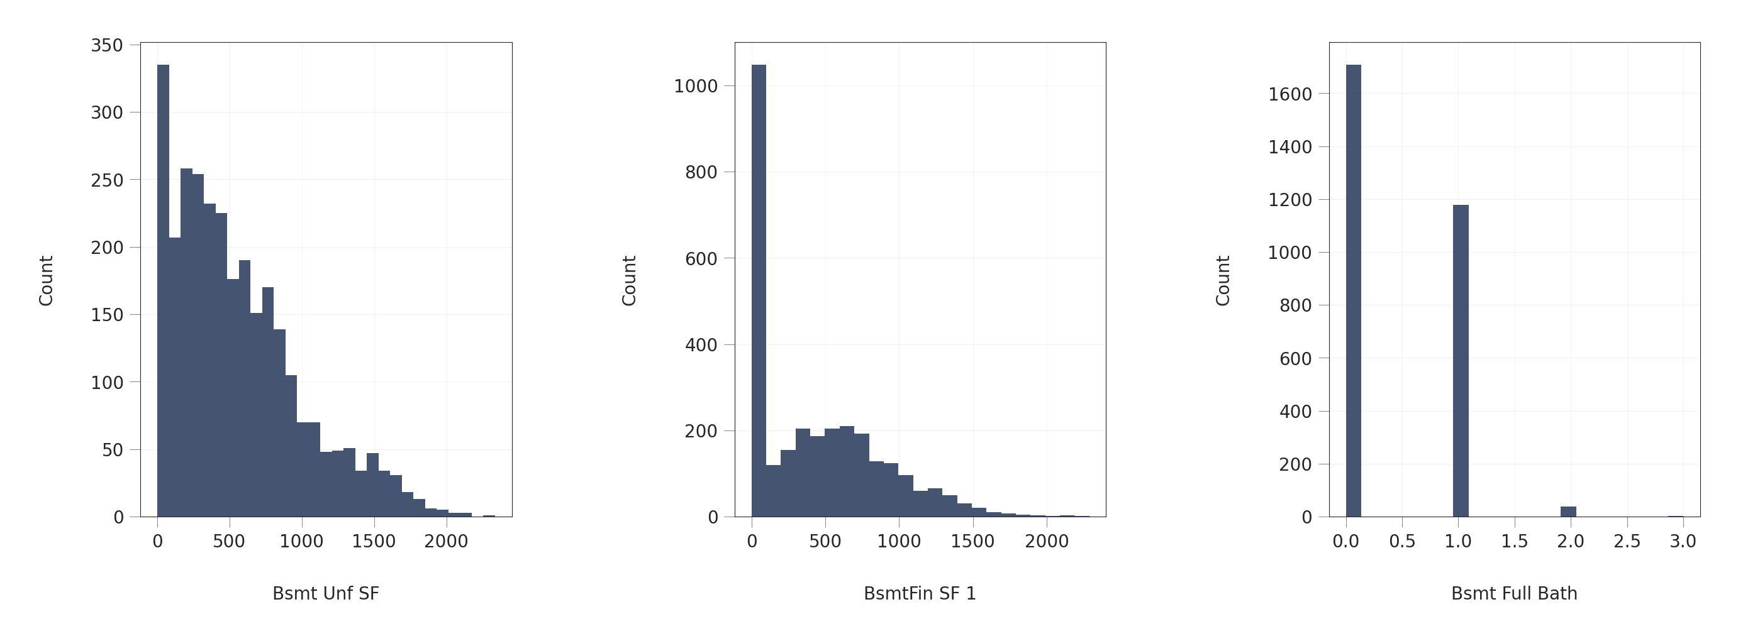
Relationship Between Predictor Variables
Negative Correlation
When I plotted the heatmap, we also discovered a significant negative correlation between Bsmt Unf SF and BsmtFin SF 1, and between Bsmt Unf SF and Bsmt Full Bath.visualize these correlations. the distribution of these variables first:

Slide 18
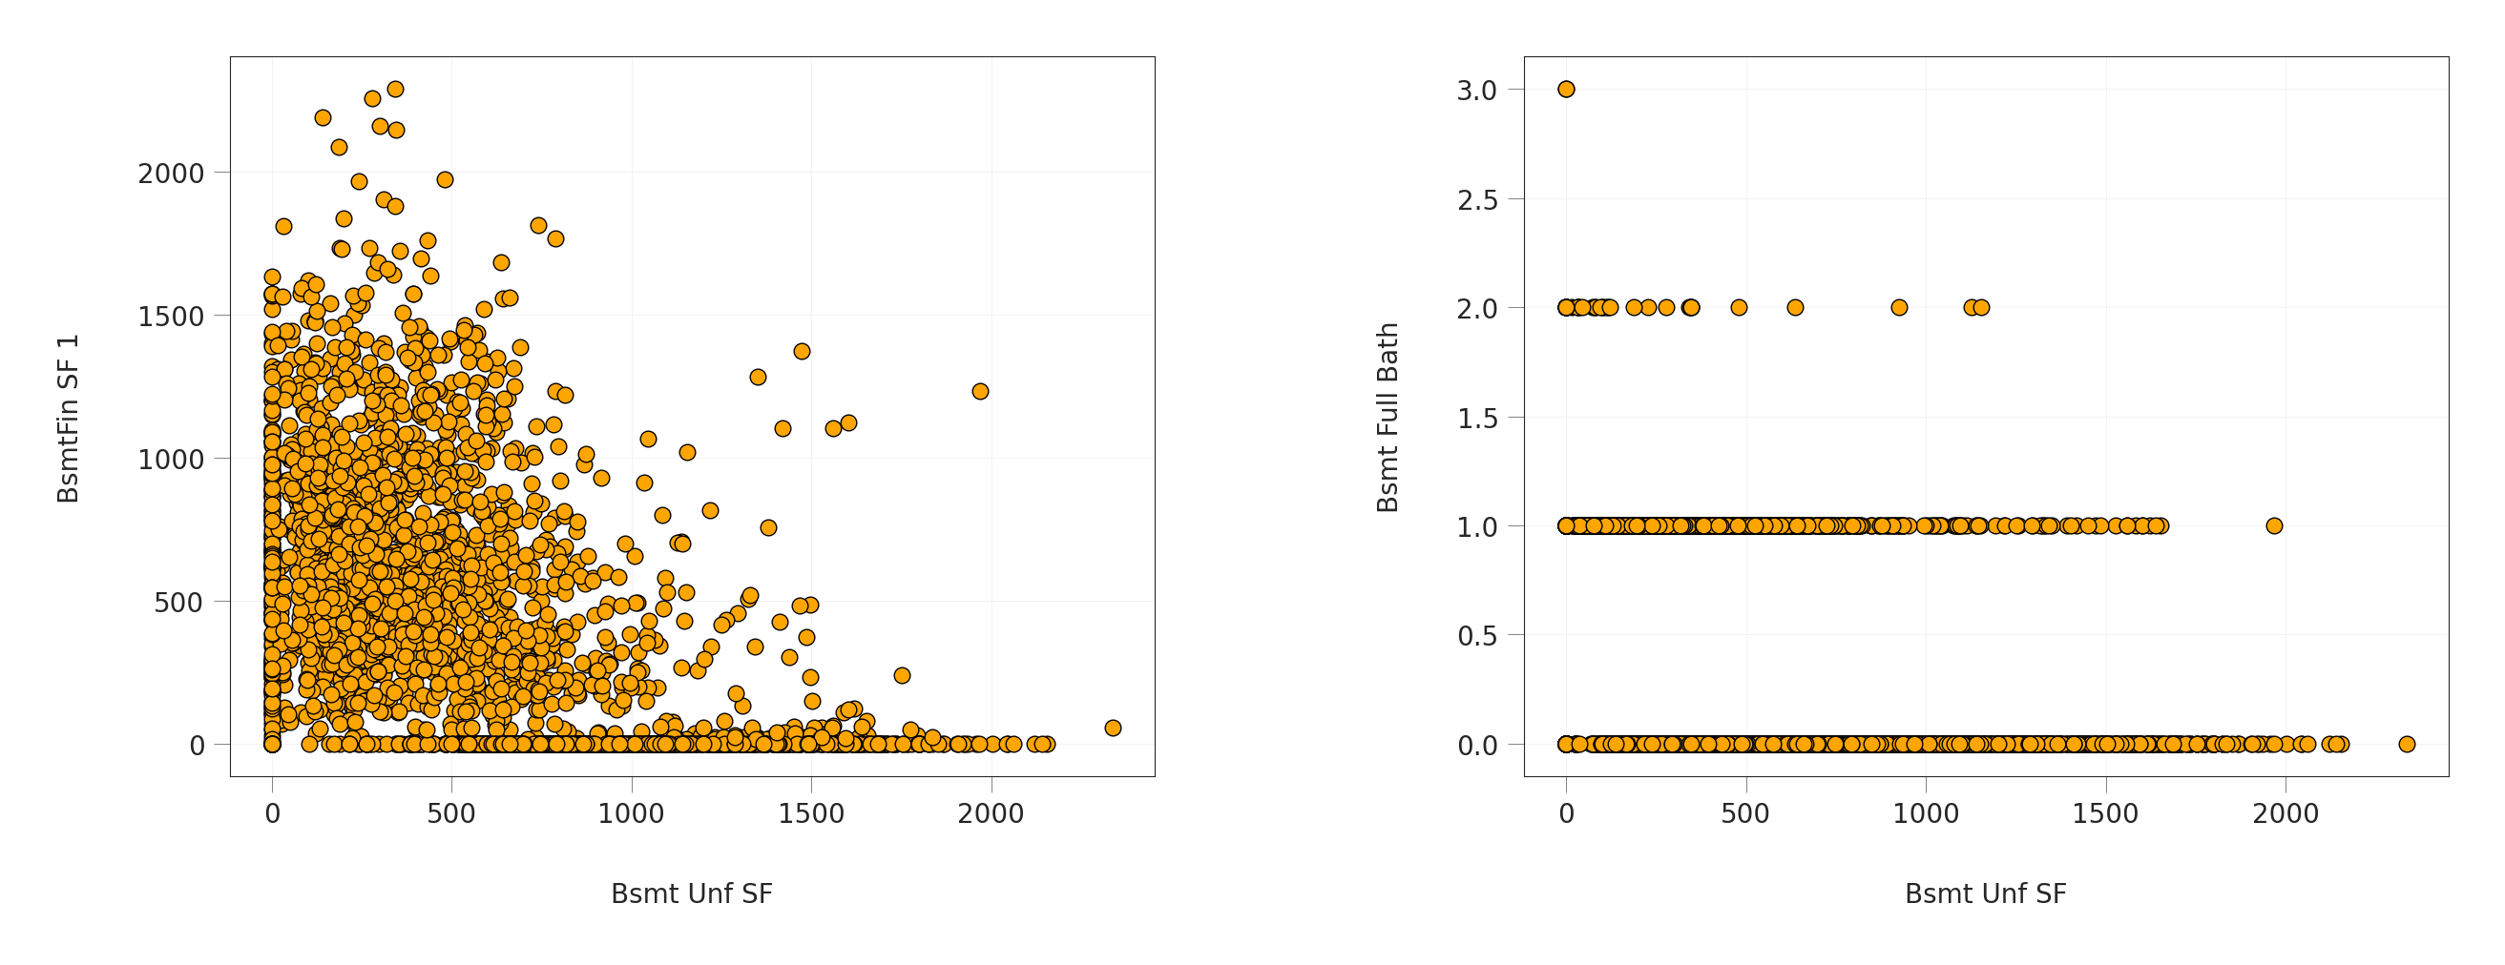
Relationship Between Predictor Variables
visualize the relationship between each pair using scatter plots:
From the plots, the negative correlation between each pair of these variables. use the information I got from exploratory data analysis in this section,I will use it in feature engineering in the next section.

Slide 19
Creating New Derived Features
A high positive correlation between the target variable SalePrice and each of Overall Qual and Gr Liv Area .The latter two features are very important in predicting the sale price. So,creating polynomial features out of these features: For each one of these features, I will derive a feature whose values are the squares of original values, and another feature whose values are the cubes of original values. Moreover, I will create a feature whose values are the product of our two features values.
There are some predictor features that are highly correlated with each other. To avoid the Multicollinearity problem, I will delete one feature from each pair of highly correlated predictors. I have two pairs: the first consists of Garage Cars and Garage Area, and the other consists of Gr Liv Area and TotRms AbvGrd. For the first pair, I will remove Garage Cars feature; from the second pair, I will remove TotRms AbvGrd feature

Slide 20
One Hot Encoding For Categorical Features
The variable Paved Drive which indicates how the driveway is paved. It has three possible values: Y which means for "Paved", P which means "Partial Pavement", and N which means "Dirt/Gravel". Let us take a look at Paved Drive value for the first few rows in dataset
We can see for example that a value of P in the original Paved Drive column is converted to 1 in Paved Drive_P and zeros in Paved Drive_N and Paved Drive_Y after one-hot encoding.
All categorical column are converted in the same way.
Prediction Type and Modeling Techniques
In this project, I want to predict the *price* of a house given information about it. The price I want to predict is a continuous value; it can be any real number. This can be seen by looking at the target vatiable in our dataset `SalePrice`.
That means that the prediction type that is appropriate to our problem is regression.

Slide 21
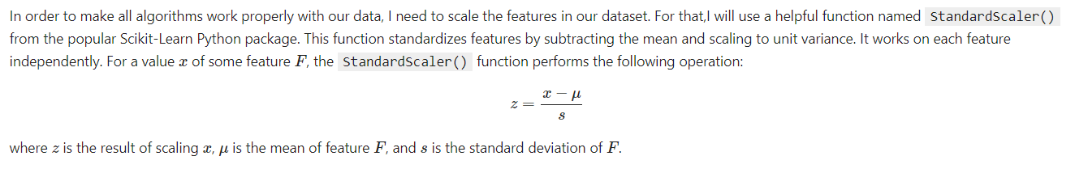
Feature Scaling

Slide 22
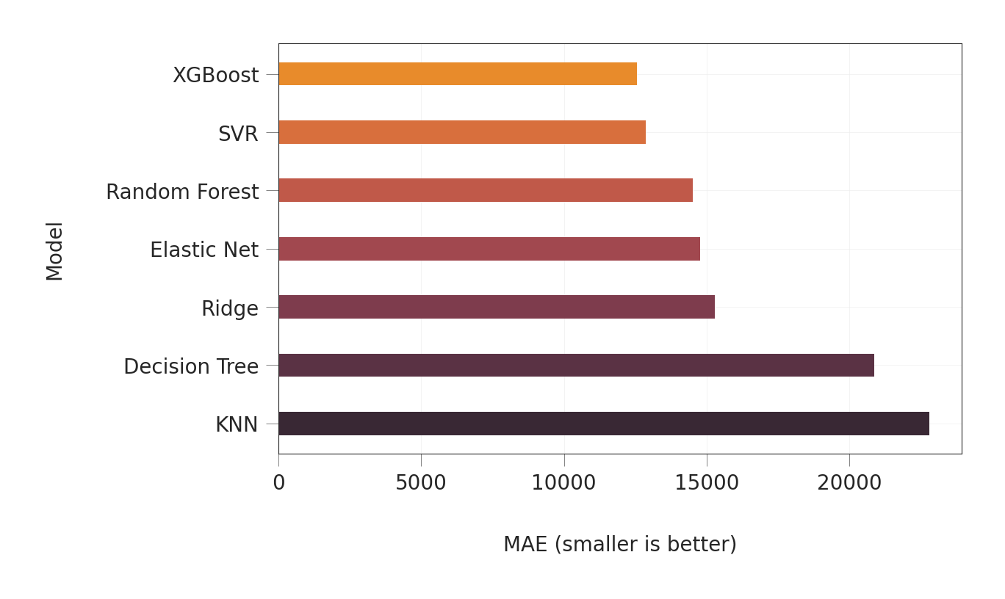
Analytics & Interpretation Of Models
By looking at the table and the graph, we can see that XGBoost model has the smallest MAE, 12556.68 followed by Support Vector Regression model with a little larger error of 12974.93. After that, Random Forest and Elastic Net models come with similar errors: 14506.46 and 14767.91 respectively. Then come Ridge with close errors: 15270.46 respectively. Then comes Decision Tree model with MAE of 20873.95, and at last, the K-Nearest Neighbors model with an error of 22780.14.
So, in our experiment, the best model is XGBoost and the worst model is K-Nearest Neighbors. We can see that the difference in MAE between the best model and the worst model is significant; the best model has almost half of the error of the worst model.

Slide 23
References
Alkhatib, K., Najadat, H., Hmeidi, I., & Shatnawi, M. K. A. (2013). Stock price prediction using k-nearest neighbor (kNN) algorithm. International Journal of Business, Humanities and Technology, 3(3), 32-44.
de Abril, I. M., & Sugiyama, M. (2013). Winning the kaggle algorithmic trading challenge with the composition of many models and feature engineering. IEICE transactions on information and systems, 96(3), 742-745.
Feng, Y., & Jones, K. (2015, July). Comparing multilevel modelling and artificial neural networks in house price prediction. In Spatial Data Mining and Geographical Knowledge Services (ICSDM), 2015 2nd IEEE International Conference on (pp. 108-114). IEEE.
Hegazy, O., Soliman, O. S., & Salam, M. A. (2014). A machine learning model for stock market prediction. arXiv preprint arXiv:1402.7351.
Ticknor, J. L. (2013). A Bayesian regularized artificial neural network for stock market forecasting. Expert Systems with Applications, 40(14), 5501-5506.
De Cock, D. (2011). Ames, Iowa: Alternative to the Boston housing data as an end of semester regression project. Journal of Statistics Education, 19(3).

